Slide 1
Stochastic Optimisation

Slide 2

$$\min{c^{T}x}$$
Subject to:
$$Ax≤b$$
$$x≥0 or x∈\left\{0,1\right\}, etc$$
What if some of $c,A$ or $b$ are random variables?
What does the problem even mean?

Slide 3
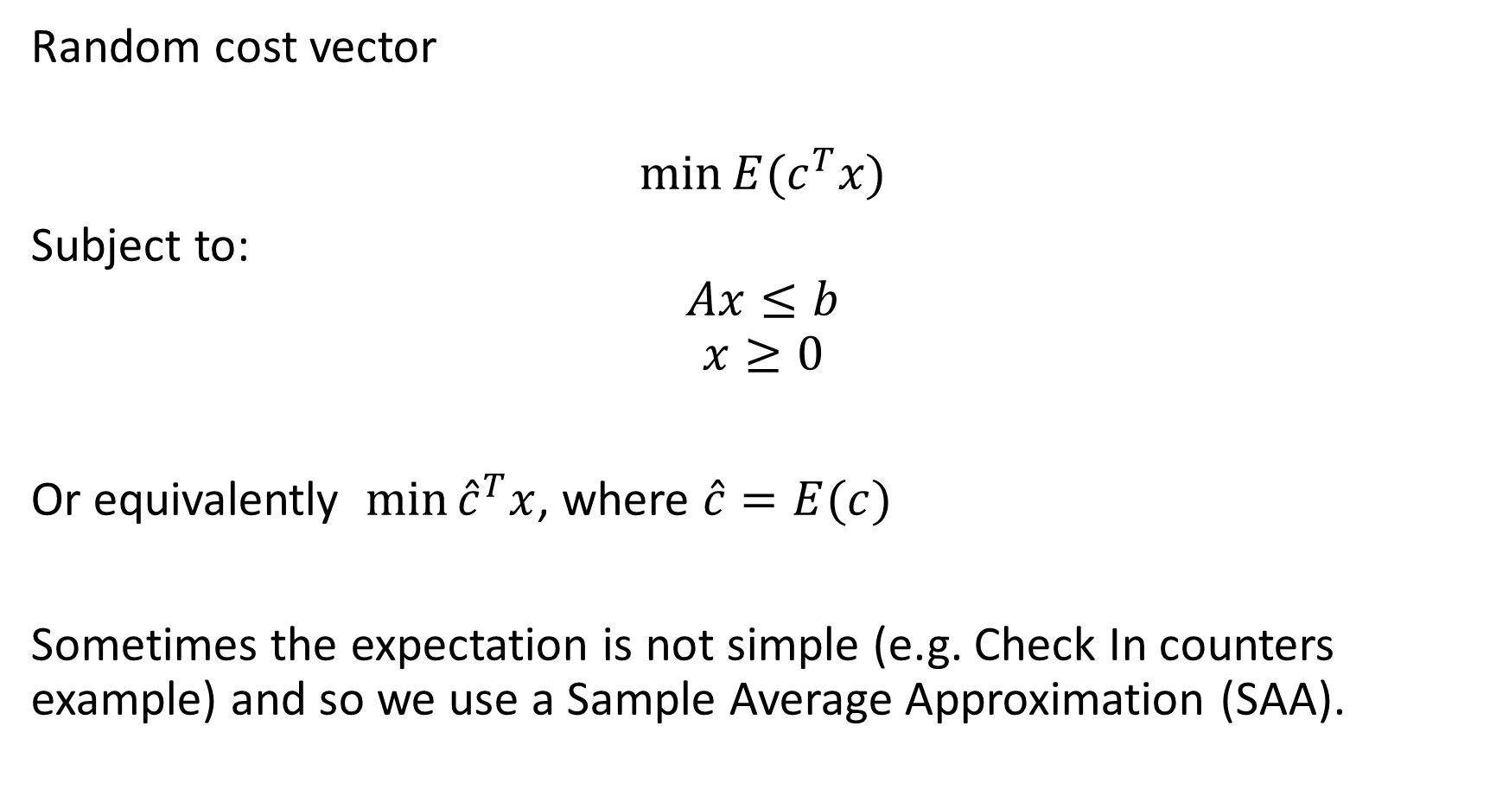
Random cost vector
$$\min{E(c^{T}x)}$$
Subject to:
$$Ax≤b$$
$$x≥0$$
Or equivalently $\min{{\hat{c}}^{T}x}$, where $\hat{c}=E(c)$
Sometimes the expectation is not simple (e.g. Check In counters example) and so we use a Sample Average Approximation (SAA).

Slide 4
But what about variance? How risky do we want to be?
Markowitz models – efficient frontier
Value at Risk (and Conditional Value at Risk)
Multi-stage scenario models
Chance constraints

Slide 5
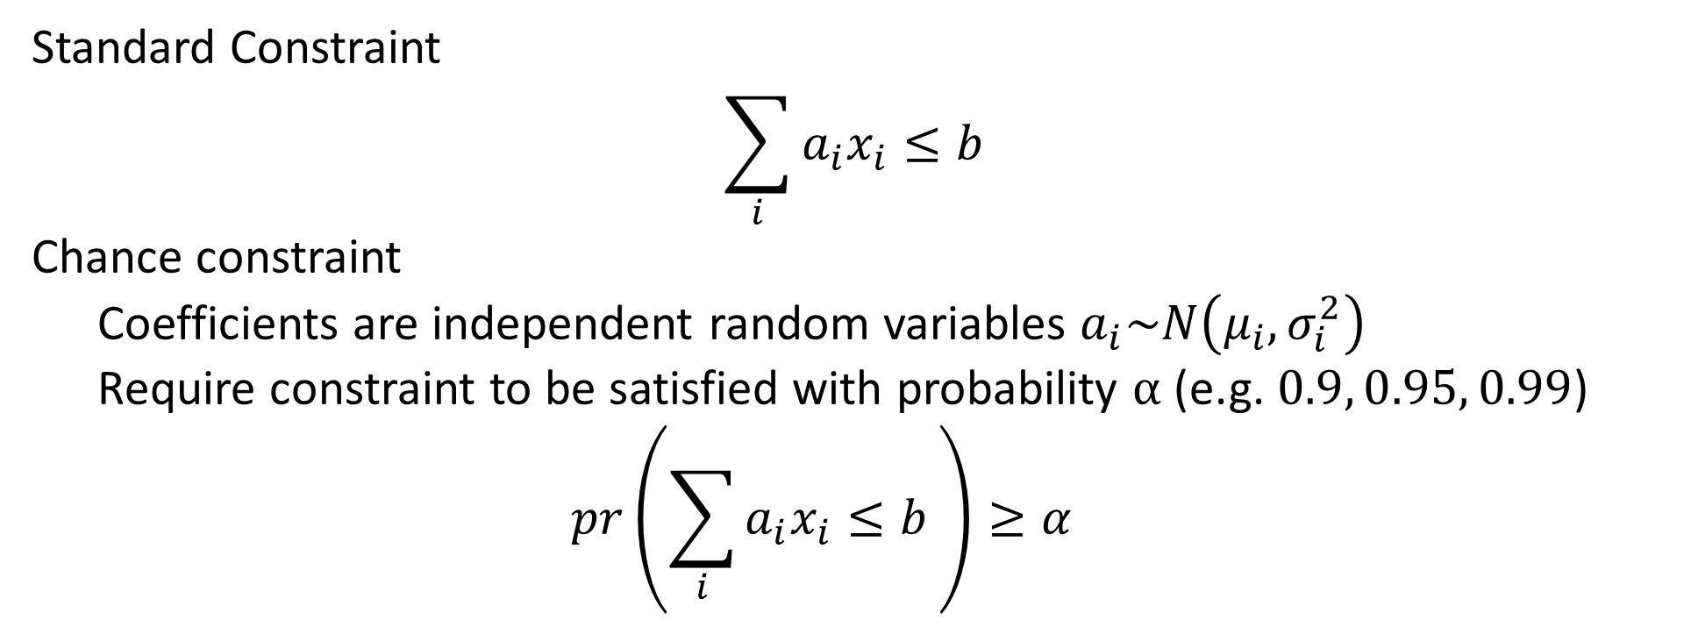
Chance Constraints
Standard Constraint
$$\sum_{i}{a_{i}x_{i}}≤b$$
Chance constraint
Coefficients are independent random variables $a_{i}\sim N\left(μ_{i},σ_{i}^{2}\right)$
Require constraint to be satisfied with probability $α$ (e.g. $0.9, 0.95, 0.99$)
$$pr\left(\sum_{i}{a_{i}x_{i}}≤b \right)≥α$$

Slide 6

New Technique – Chance Constraints
$$\sum_{i}{μ_{i}x_{i}}+F^{−1}\left(α\right){\left(\sum_{i}{σ_{i}^{2}x_{i}^{2}}\right)}^{\frac{1}{2}}≤b$$
$${F^{−1}\left(α\right)}^{2}\left(\sum_{i}{σ_{i}^{2}x_{i}^{2}}\right)≤{\left(b−\sum_{i}{μ_{i}x_{i}}\right)}^{2}$$
Add $w_{i}=F^{−1}\left(α\right)σ_{i}x_{i}$ and $z= b−\sum_{i}{μ_{i}x_{i}}$ to get
$$w^{T}w≤z^{2}$$
Notes:
Second order cone constraint. Gurobi/Cplex can handle these native with their barrier solvers.

Slide 7
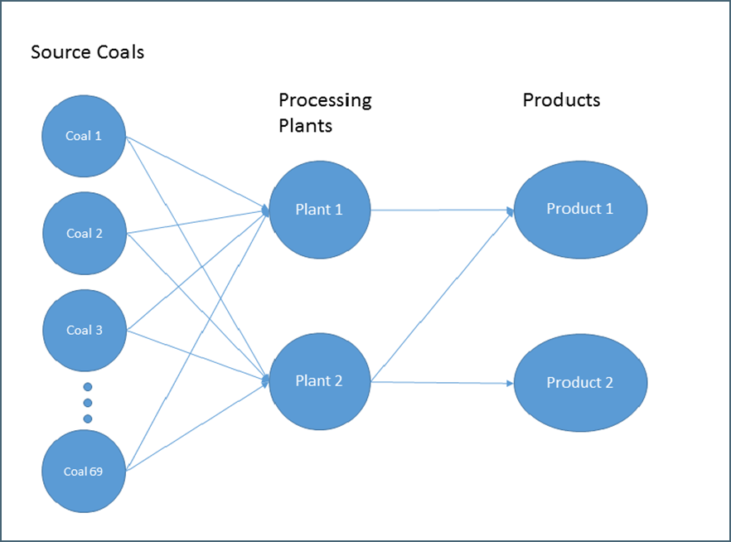
Structure of coal model
New Problem – Coal Blending
Multiple source coals
Blended at multiple processing facilities
Which operate in multiple modes
To produce multiple products
Over multiple time periods
Allows non-linear pricing functions
Gives exact solutions
Uses deterministic and or stochastic quality constraints
Optimal Blending Strategies for Coking Coal using Chance Constraints. Jeuken, Forbes, Kearney (2019)

Slide 8
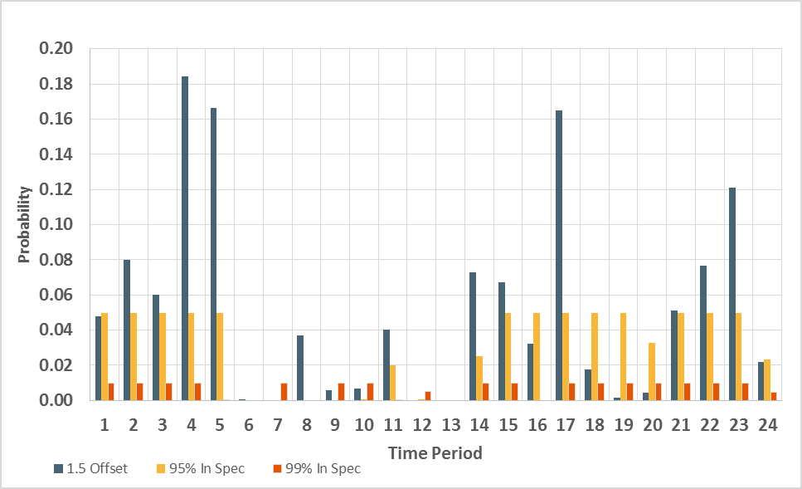
Lower variability than determistic model
New Problem – Coal Blending

Slide 9
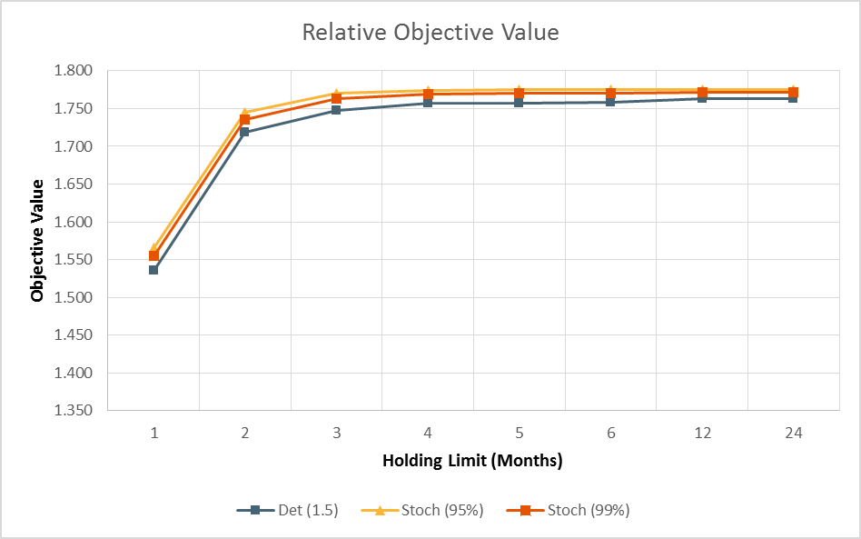
At cheaper cost
New Problem – Coal Blending
Notes:
We’ll go on to look at variability in the mining process.
And blending other ores – e.g. copper and gold which are log normal, iron ore – one sided.

Slide 10
Combined with other techniques
Pickup and Delivery Problems
Chance constraints
Stochastic optimisation
Work with Emily Sawrey
Notes:
I would never have considered this except Emily wanted to do something on Stochastic Vehicle Routing

Slide 11
Pickup And Delivery Problem with Time Windows
D1
D5
P3
P1
P5
P8
D8
D7
D9
D3
D2
D6
P9
P10
D4
P4
P6
P7
D10
P2
Notes:
Variant of PDPTW

Slide 12
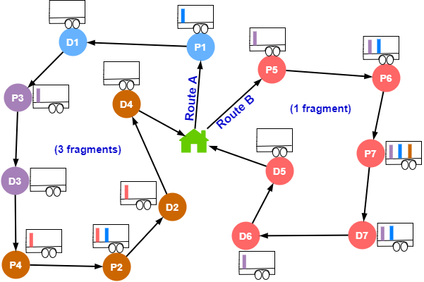
Pickup And Delivery Problem with Time Windows
Fragments:
A sub-path where the vehicle arrives empty at the pickup node and departs empty from the delivery node.
Vehicle cannot be empty at any intermediate node.
Fragments respect all capacity, time window, pairing and precedence constraints, as well as any other loading constraint e.g. ride time.
An Exact Algorithm for the Pickup and Delivery Problem with Time Windows … Alyasiry, Forbes, Bulmer (2019)
Notes:
We only came up with this because Ali needed to do Rich Variants of VRP as his thesis.

Slide 13
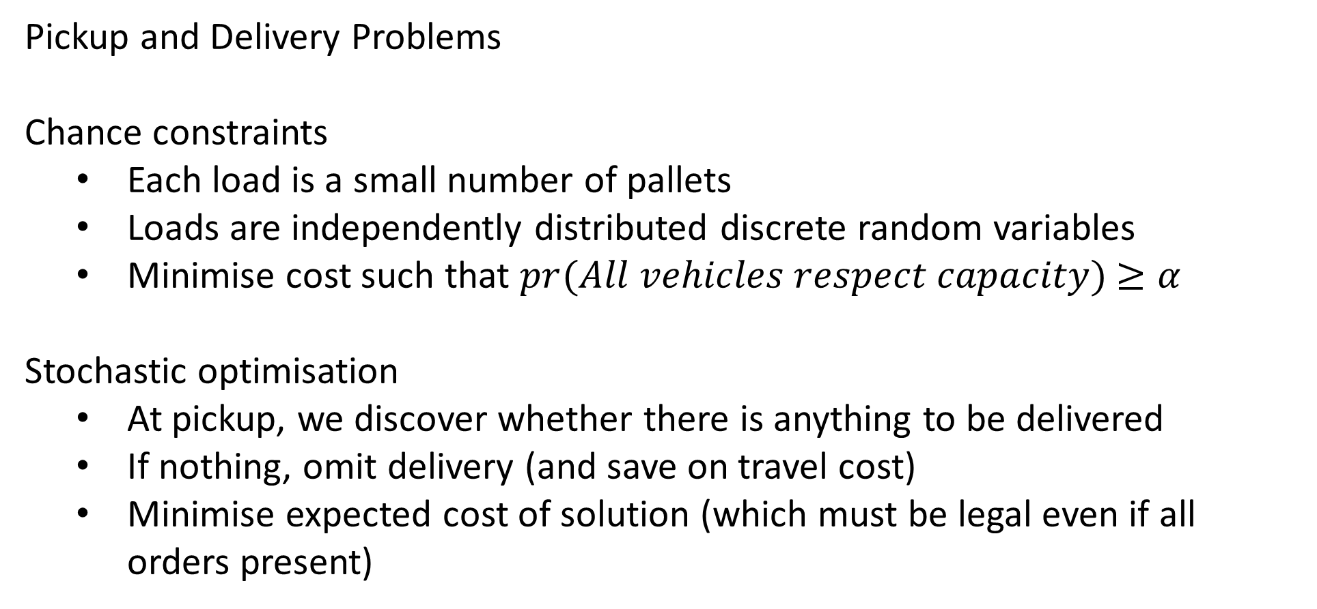
Old problem – new techniques
Pickup and Delivery Problems
Chance constraints
Each load is a small number of pallets
Loads are independently distributed discrete random variables
Minimise cost such that $pr(All vehicles respect capacity)$ $≥α$
Stochastic optimisation
At pickup, we discover whether there is anything to be delivered
If nothing, omit delivery (and save on travel cost)
Minimise expected cost of solution (which must be legal even if all orders present)

Slide 14
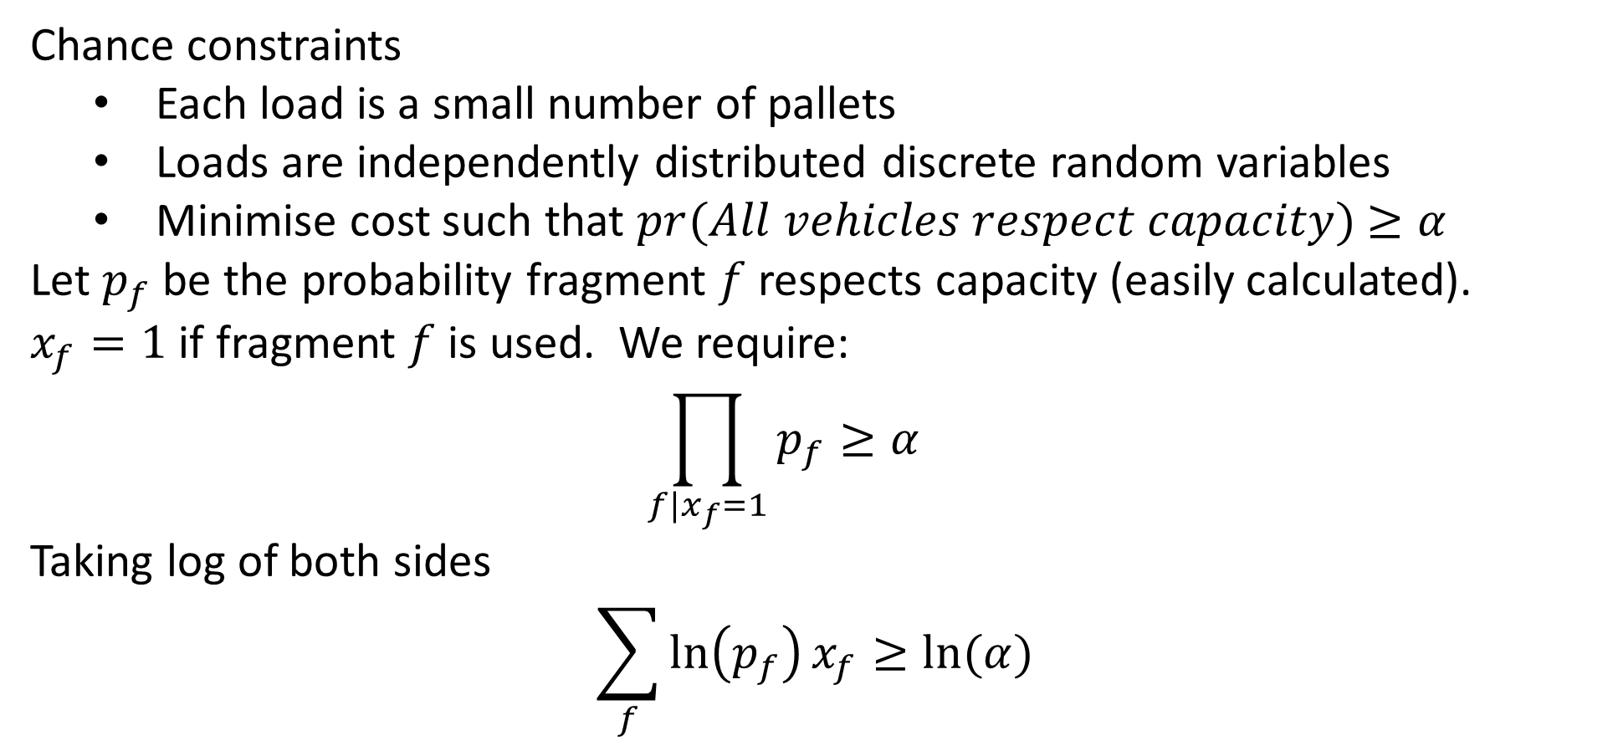
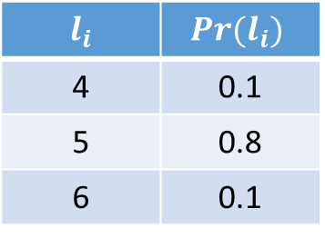
Old problem – new techniques
$$l_{i}$$ | $Pr(l_{i})$
4 | 0.1
5 | 0.8
6 | 0.1
Chance constraints
Each load is a small number of pallets
Loads are independently distributed discrete random variables
Minimise cost such that $pr(All vehicles respect capacity)$ $≥α$
Let $p_{f}$ be the probability fragment $f$ respects capacity (easily calculated). $x_{f}=1$ if fragment $f$is used. We require:
$$\prod_{f|x_{f}=1}{p_{f}}≥α$$
Taking log of both sides
$$\sum_{f}{\ln\left(p_{f}\right)x_{f}}≥ln⁡(α)$$
Notes:
Nice closed form expression which just works, for a pretty practical problem.
I would never have though of this without my student.

Slide 15
Chance Constraints
Standard Constraint
$$\sum_{i}{a_{i}x_{i}}≤b$$
Chance constraint
Coefficients are independent random variables $a_{i}\sim N\left(μ_{i},σ_{i}^{2}\right)$
Require constraint to be satisfied with probability $α$ (e.g. $0.9, 0.95, 0.99$)
$$pr\left(\sum_{i}{a_{i}x_{i}}≤b \right)≥α$$

Slide 16
Chance Constraints - Normal
$$\sum_{i}{μ_{i}x_{i}}+F^{−1}\left(α\right){\left(\sum_{i}{σ_{i}^{2}x_{i}^{2}}\right)}^{\frac{1}{2}}≤b$$
$${F^{−1}\left(α\right)}^{2}\left(\sum_{i}{σ_{i}^{2}x_{i}^{2}}\right)≤{\left(b−\sum_{i}{μ_{i}x_{i}}\right)}^{2}$$
Add $w_{i}=F^{−1}\left(α\right)σ_{i}x_{i}$ and $z= b−\sum_{i}{μ_{i}x_{i}}$ to get
$$w^{T}w≤z^{2}$$
Notes:
Second order cone constraint. Gurobi/Cplex can handle these native with their barrier solvers.

Slide 17
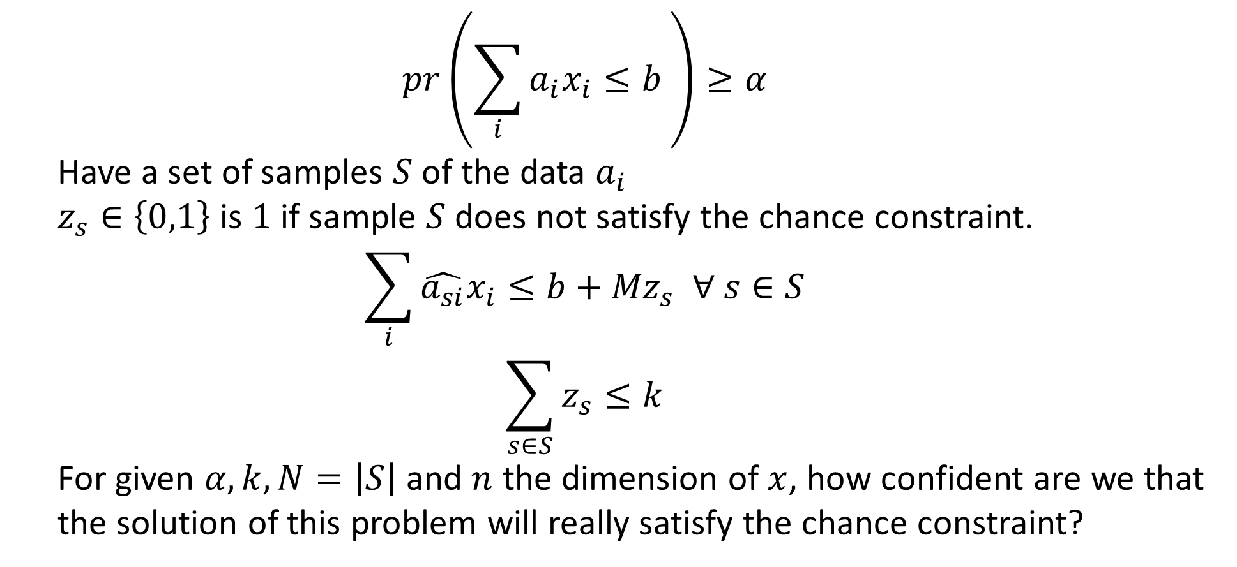
Chance Constraints – Sample Average Approximation
$$pr\left(\sum_{i}{a_{i}x_{i}}≤b \right)≥α$$
Have a set of samples $S$ of the data $a_{i}$
$z_{s}∈\left\{0,1\right\}$ is $1$ if sample $S$ does not satisfy the chance constraint.
$$\sum_{i}{\hat{a_{si}}x_{i}}≤b+{Mz}_{s} ∀ s∈S$$
$$\sum_{s∈S}{z_{s}≤k}$$
For given $α,k,N=\left|S\right|$ and $n$ the dimension of $x$, how confident are we that the solution of this problem will really satisfy the chance constraint?

Slide 18
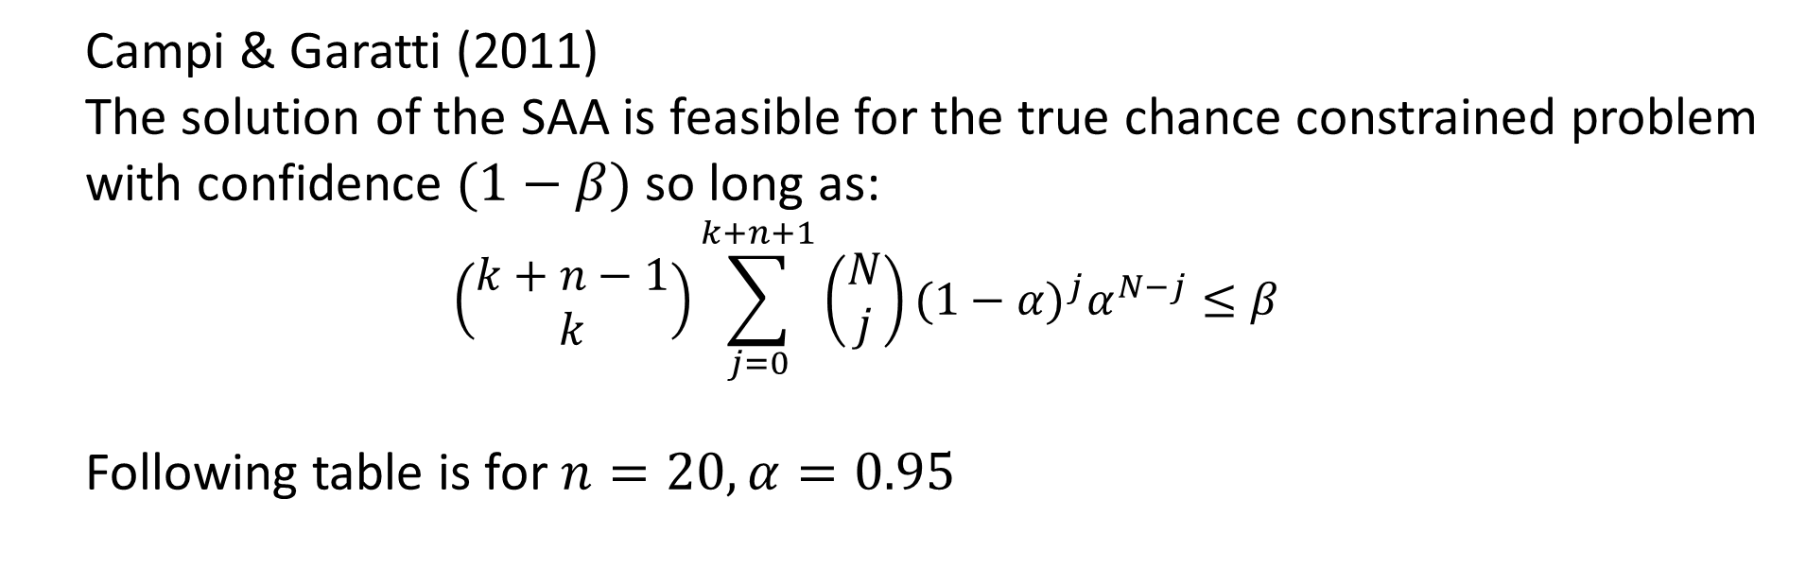
Chance Constraints – Sample Average Approximation
Campi & Garatti (2011)
The solution of the SAA is feasible for the true chance constrained problem with confidence $(1−β)$ so long as:
$$\left(\begin{matrix}k+n−1 \\ k\end{matrix}\right)\sum_{j=0}^{k+n+1}{\left(\begin{matrix}N \\ j\end{matrix}\right){(1−α)}^{j}α^{N−j}}≤β$$
Following table is for $n=20, α=0.95$

Slide 19
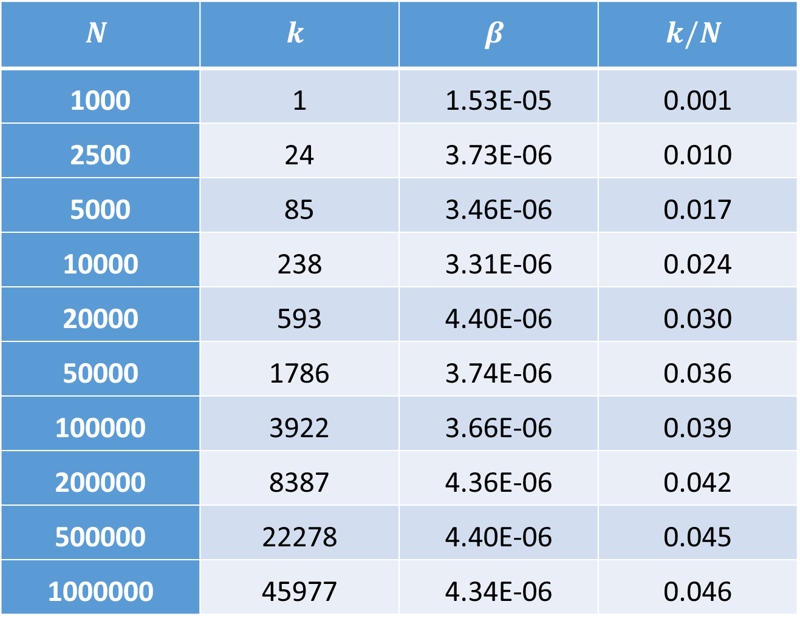
Chance Constraints – Sample Average Approximation
$$N$$ | $$k$$ | $$β$$ | $$k/N$$
1000 | 1 | 1.53E-05 | 0.001
2500 | 24 | 3.73E-06 | 0.010
5000 | 85 | 3.46E-06 | 0.017
10000 | 238 | 3.31E-06 | 0.024
20000 | 593 | 4.40E-06 | 0.030
50000 | 1786 | 3.74E-06 | 0.036
100000 | 3922 | 3.66E-06 | 0.039
200000 | 8387 | 4.36E-06 | 0.042
500000 | 22278 | 4.40E-06 | 0.045
1000000 | 45977 | 4.34E-06 | 0.046

Slide 20
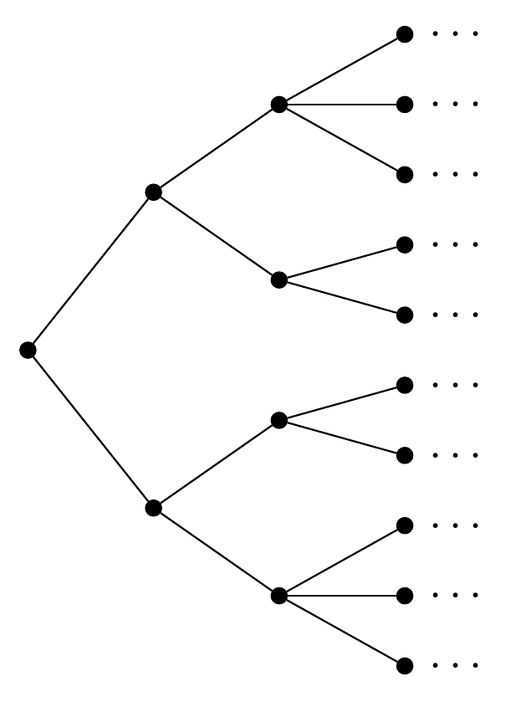
Scenario Tree

Slide 21
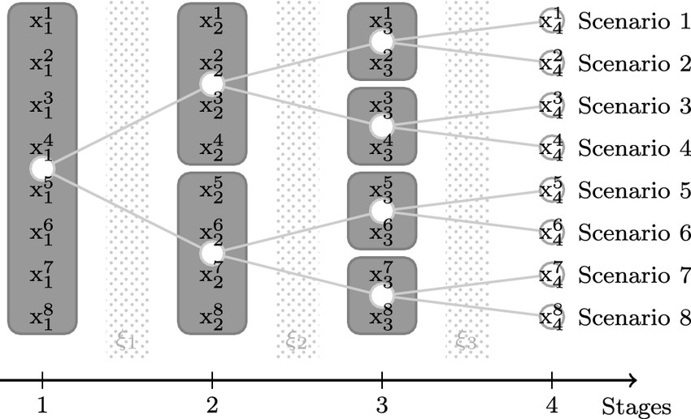
Non-anticipating constraints

